Slide 1


Unifying Application Development with .NET Core 3.0
Santhakumar Munuswamy
Technical Architect

Slide 2


Who am I?
Santhakumar Munuswamy
Sr. Technical Lead @Pointel Solutions
Certified Scrum Master, Speaker, Blogger
Blog: http://www.san2debug.net/
@msanthakumara
santhakumarmunuswamy

Slide 3
Agenda
Visual Studio first release
.NET Roadmaps
Unifying .NET Platform
.NET Standard
Unifying all things
Ship to .NET
Unifying Windows apps
Demo
Conclusion

Slide 4
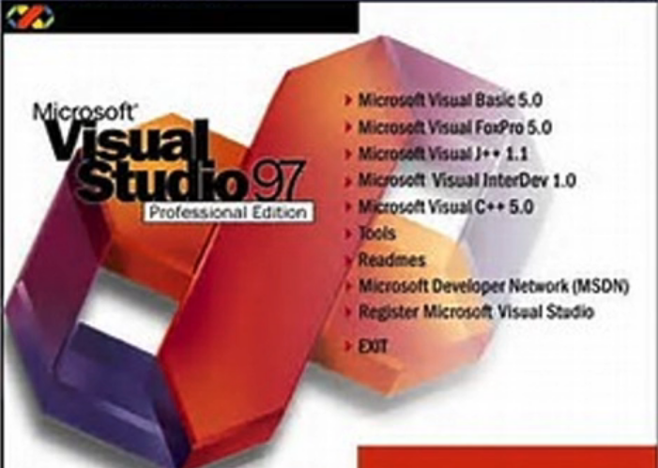




Visual Studio first released -1997
First step to “unifying developer tools”
Bundled all tools into one installer
First attempt at using the same development environment for multiple products (C++, J++ & InterDev)
J++ based on Microsoft Java Virtual Machine
Vision was to develop the best tools for JVM

Slide 5

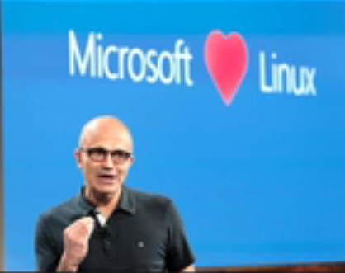
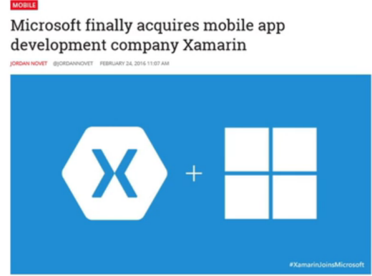
.NET Roadmaps
.NET is born - 2002
Core components:- CLI, CTS, CLR
Supported Languages:- C#, VB.NET, C++ & many more (F# in 2007)
Unified IDE – Visual Studio.NET
.NET goes “Open Source” - 2014
.NET Compiler Platform “Roslyn” released open source
.NET Core project begins (CoreFx, CoreCLR repos)
New Implementation of .NET geared for hyper-scale, cloud development and small device/ IoT development
Cross-platform, lightweight, better performance
Microsoft acquires “Xamarin” - 2016
Cross-platform, native, mobile development with .NET
Mono officially supported and contributions from Microsoft
Mono project joins the .NET Foundation

Slide 6
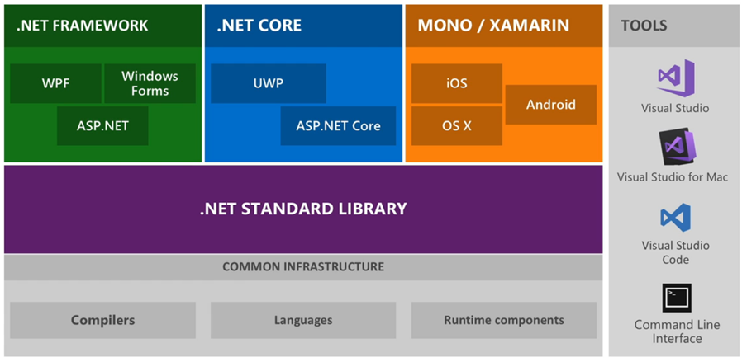
Unifying .NET Platform - 2017

Slide 7
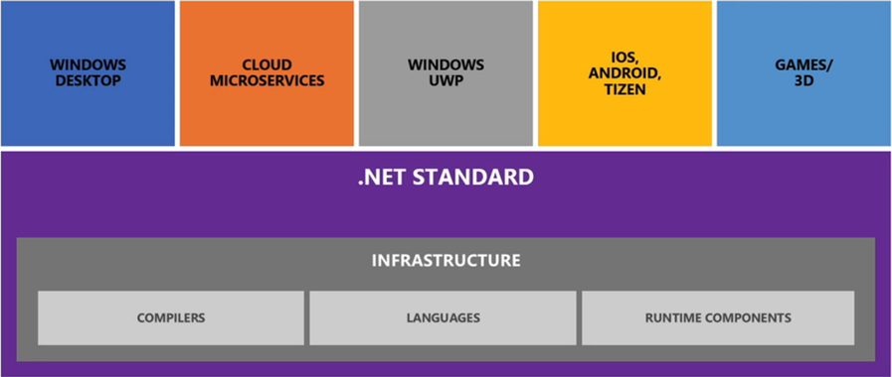
.NET Standard
It allows sharing code, binaries and skills between .NET implementations
It’s provides a specification for any platform to implement
All .NET runtimes provided by Microsoft implement the standard

Slide 8
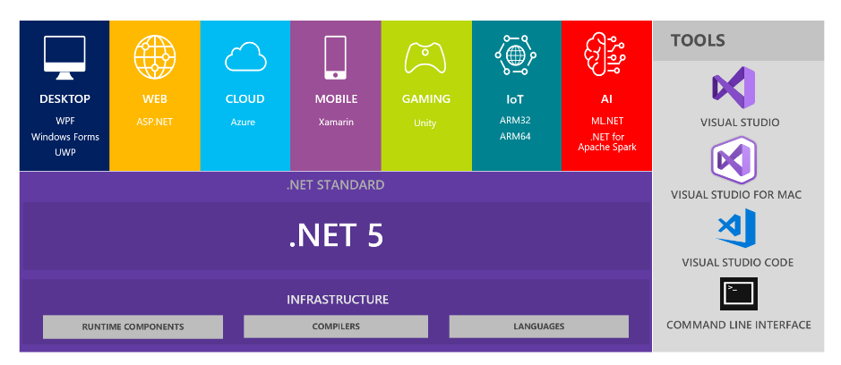
Unifying .NET Platform - 2020

Slide 9
.NET – Unifying all the “things”
Produce a single .NET runtime and framework that can be used everywhere and that has uniform runtime behavior and developer experience.
Expand the capabilities of .NET by taking the best of .NET Core, .NET Framework, Xamarin and Mono.
Build that product out of a single code-base that developers (Microsoft and the community) can work on and expand together and that improves all scenarios.
Additionally
You will have more choice on runtime experiences (more on that below)
Java interoperability will be available on all platforms.
Objective-C and Swift Interoperability will be supported on multiple operating
CoreFx will be extended to support static compilation of .NET, smaller footprints and support for more operating systems.

Slide 10
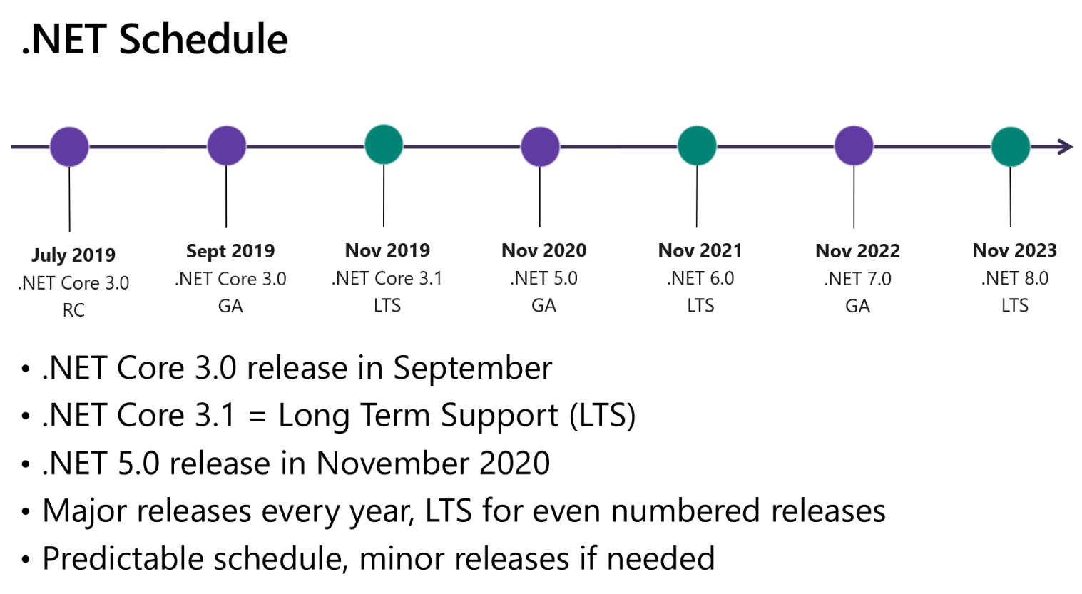
Ship .NET Core 3.0 & .NET 5

Slide 11
Unifying Windows Apps
Reasons to port to .NET Core
NET core is the fast innovating . NET
Deployment Flexibility
Runtime, BCL and language features
Performance
Desktop Improvements
UI Framework Enhancements
XAML Islands and XAML controls
High DPI fixes for WinForms
Access to all the Windows 10 APIs

Slide 12
Windows Apps
DEMO/Windows Apps

Slide 13
Reference
https://devblogs.microsoft.com/dotnet/introducing-net-5/
https://vimeo.com/223525394
https://devblogs.microsoft.com/dotnet/how-to-port-desktop-applications-to-net-core-3-0/
https://channel9.msdn.com/Events/Visual-Studio/Visual-Studio-2019-Launch-Event/Unifying-Windows-desktop-development-with-NET-Core-30
https://marketplace.visualstudio.com/items?itemName=BrianLagunas.ConvertProjectToNETCore3&ssr=false#review-details

Slide 14
Thank you.
Santhakumar Munuswamy
Sr. Technical Lead,
Pointel Solutions
santhakumar@san2debug.net
www.san2debug.net
@san2debug
@msanthakumara

